Slide 1
JavaScript Portfolio Site with GitHub Codespaces
Create, customize and deploy your own portfolio website in minutes.

Slide 3




About this template
Audience
Educators of all levels
Zero Experience
required from students
Can I use this template for other Web Frameworks?
No requirements
Notes:
With this JavaScript Codespace template you can immediately create a normalized environment to teach or learn web development. This enables you to focus on the web development content you are teaching, and let Codespaces handle the environment setup for you.
Who is this for? Educators of all levels, and those looking for a great template to build a web app.
How much experience do students need? Zero. This template is built with basic elements complete with comments so it can be used in beginner to advanced lessons.
Can I use this template for other Web Frameworks? Absolutely. This template uses React as an example, but instructions are included in this document to help you use this template with your web framework.
Prerequisites: None. This template will provide a working and deployable web app you can immediately extend for your needs.

Slide 4


About this portfolio template
We have a React based web application ready for you to easily customize and deploy using only your web browser.
Notes:
About this portfolio template
In this "choose your own adventure" template portfolio, we have a React based web application ready for you to easily customize and deploy using only your web browser.

Slide 5
JavaScript portfolio template
http://aka.ms/JSCodespacesProject
Notes:
This repo is a GitHub template to build a JavaScript personal portfolio frontend web application using the React framework. The goal is to give you a template to you can immediately utilize to create your own website through Codespaces.

Slide 6
Important files
/.devcontainer
.devcontainer/Dockerfile
determine operating system and other details.
.devcontainer/devcontainer.json
Configuration file used by Codespaces to configure Visual Studio Code settings, such as the enabling of additional extensions.
Notes:
The repo contains the following:
/.devcontainer
.devcontainer/Dockerfile: Configuration file used by Codespaces to determine operating system and other details.
.devcontainer/devcontainer.json: Configuration file used by Codespaces to configure Visual Studio Code settings, such as the enabling of additional extensions.

Slide 7
Important files
/src
.eslintrc
.prettierrc
package.json and package-lock.json
Notes:
/src: HTML, JS and CSS files used to build your portfolio site.
.eslintrc: Settings for ESLint that is included for code consistency and quality.
.prettierrc: Settings for Prettier that is used to format code.
package.json and package-lock.json: Defines the project information for Node.js, dependent packages and the versions needed of each.

Slide 8
Getting started
🚀
Simple React application
Parcel in place to build your site when deploying
Code linting and formattting using ESLint and Prettier for code consistency.
Notes:
This portfolio site project is filled with sample data so that you can immediately open in Codespaces, see it running, and deploy at any point.
Your development environment is all set for you to start. Based on our JavaScript Codespace Template (React), here is what s already setup and ready for you to use:
Simple React application with components for each section of the portfolio site
Parcel in place to build your site when deploying
Code linting and formattting using ESLint and Prettier for code consistency.

Slide 9

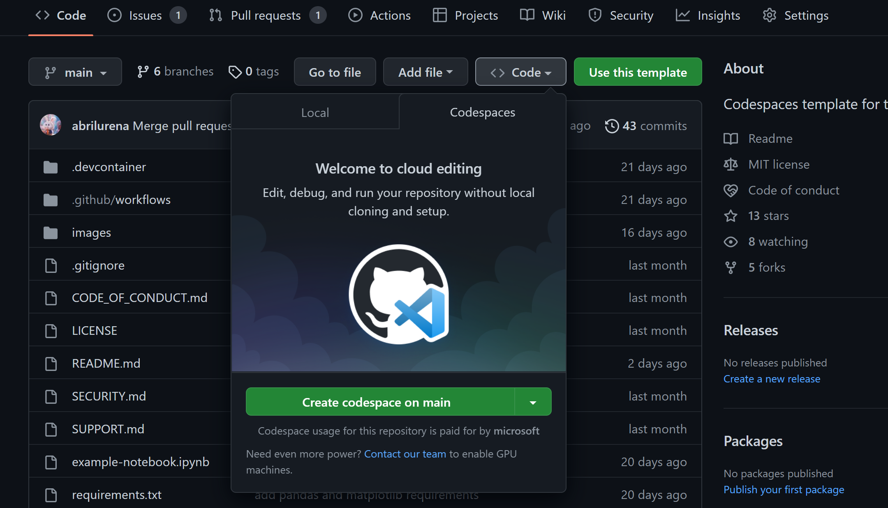



Create your portfolio
following these steps:
Create a repo from this template.
Use this create repo link
Navigate to the main page of the newly created repository.
Under the repository name, use the Code drop-down menu, and in the Codespaces tab, select "Create codespace on main".
Notes:
To run what's in this repository, you need to first start a Codespaces instance.
Create a repository from this template. Use this create repo link. Select the repository owner, provide a name, a description if you'd like and if you'd like the new repository to be public or private.
Navigate to the main page of the newly created repository.
Under the repository name, use the Code drop-down menu, and in the Codespaces tab, select "Create codespace on main".

Slide 10
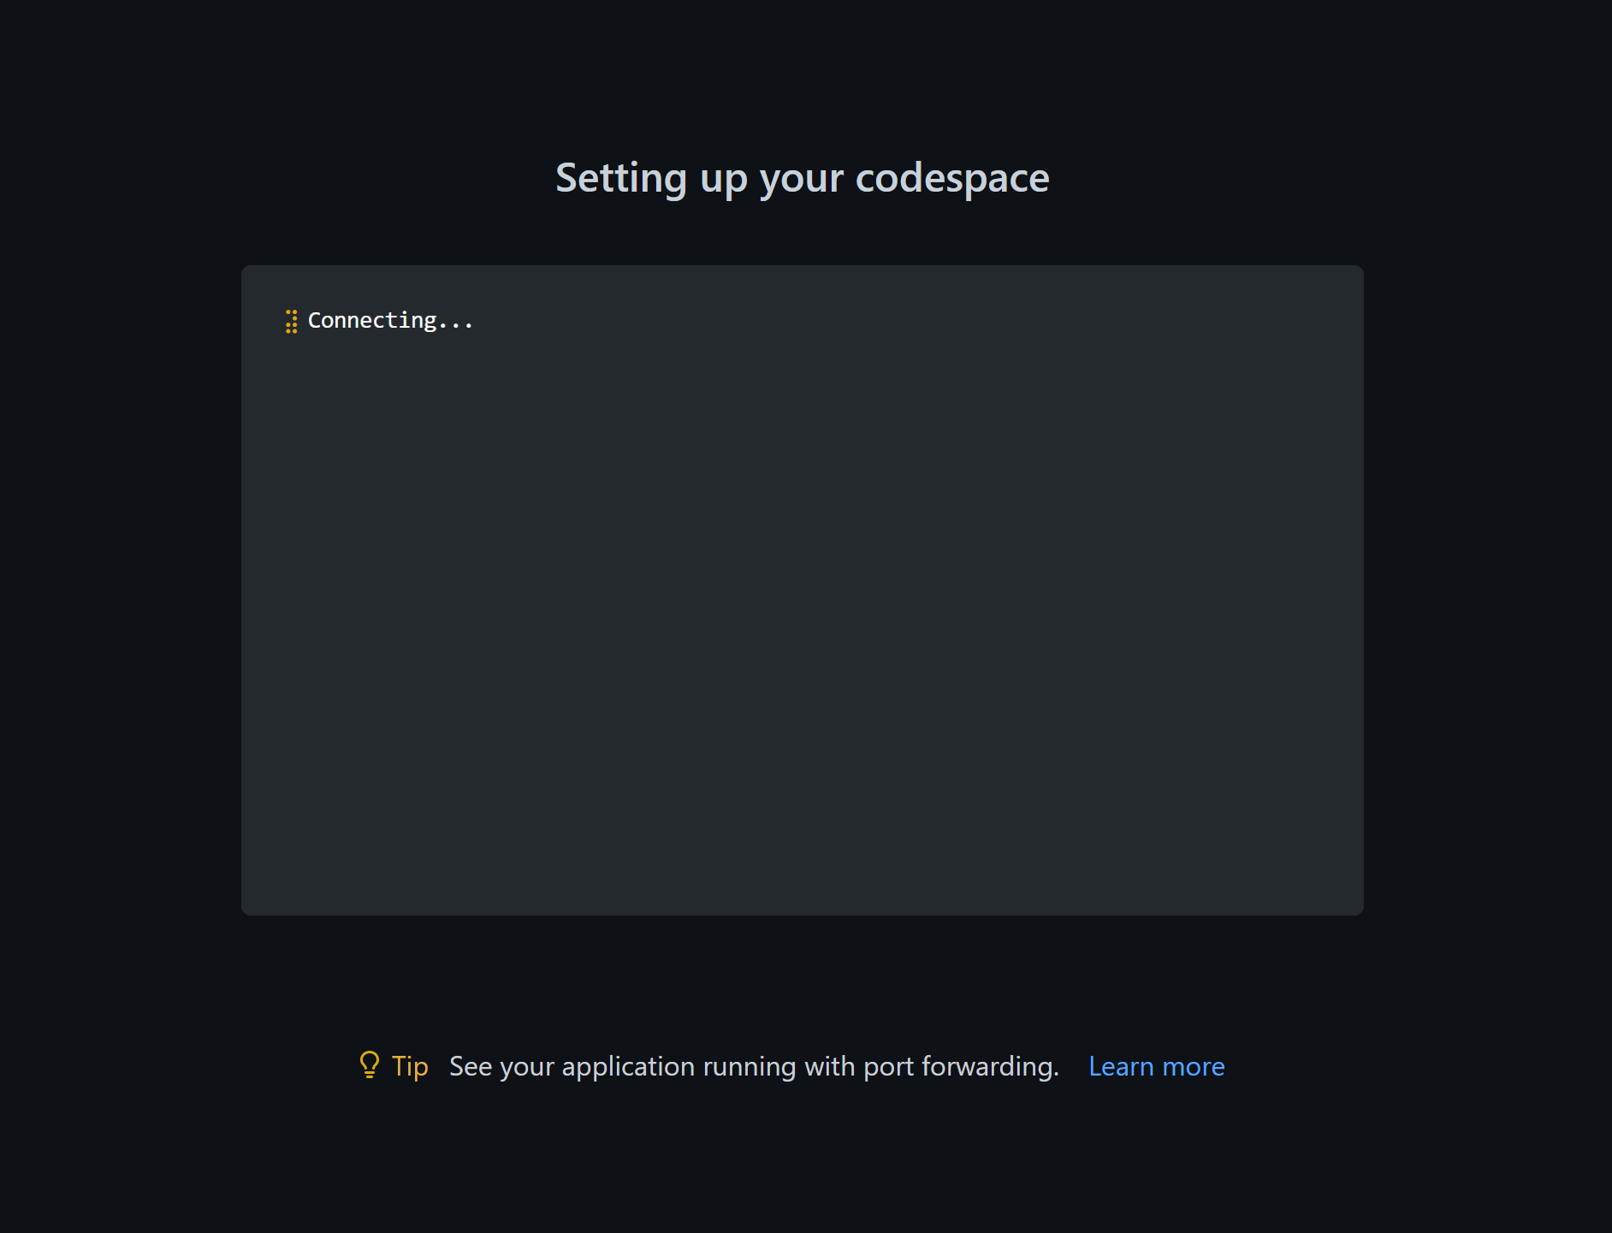
🚀 Run this template
following these steps:
Wait as GitHub initializes the Codespace
Notes:
4. Wait as GitHub initializes the Codespace.

Slide 11
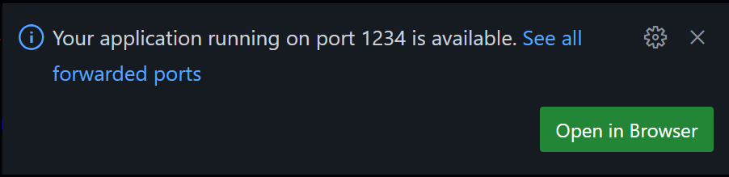
🚀 Run this template
following these steps:
When complete you will see your Codespace load with a terminal section at the bottom.
Notes:
When complete you will see your Codespace load with a terminal section at the bottom. Here you will see npm install executing. When complete you will return to the terminal prompt where you can run the web application by executing: npm run start
When the web application is started you will see a prompt telling you it started successfully on port 1234, and you can open that site within your browser:

Slide 12
Customize your site in 3 steps
Notes:
This project is built to be easily customizable. Each section of the site is a separate component, and your information needs to be set in only one spot. This is not only for ease of updating, but so you can see how prop values are passed to React components.
For each step, open the project in Codespaces, then you can make and commit your changes while within your Codespace.
See Using source control in your codespace for more Codespaces source control how-tos

Slide 13



Customize your site in 3 steps
Add your "about me" and social accounts
Update images
Add items you've worked on
Notes:
Here are the steps to follow your personalized website.

Slide 14
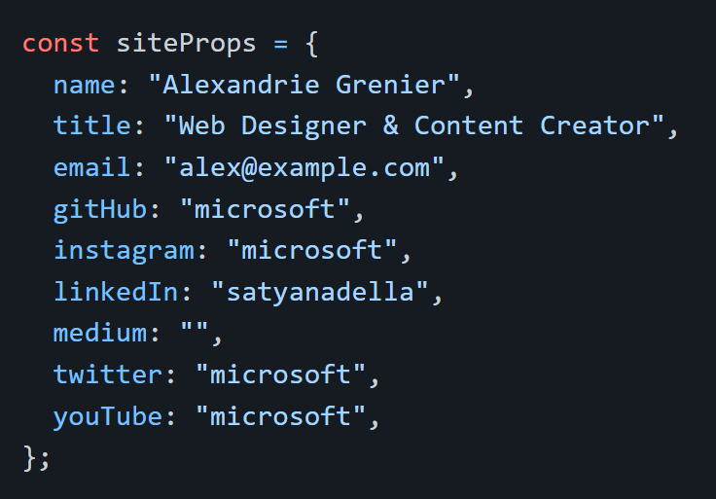
1. Add your "about me" and social accounts
Within App.jsx you will see a variable called siteProps.
Notes:
1. Add your “about me” and social accounts
Within App.jsx you will see a variable called siteProps. This is a JavaScript object that hold the key value pairs needed to customize your name, title, email and social accounts.
const siteProps = { name: "Alexandrie Grenier",
title: "Web Designer & Content Creator",
email: "alex@example.com",
gitHub: "microsoft",
instagram: "microsoft",
linkedIn: "satyanadella",
medium: "",
twitter: "microsoft",
youTube: "microsoft", };
Update to the name and title you'd like displayed at the top of your site.
Optional values are email address and social accounts. These are used in the Footer component. If any item is not included in the list, or set to an empty string ("") it will not display the icon and link.

Slide 15



2. Update images
Home.jsx
About.jsx
Portfolio.jsx
Notes:
2️⃣ Update images
This portfolio site includes 3 images: top section background, "About me" background and portfolio section (desk). These can be any landscape sized images of your choosing from your own collection or found that have a license allowing you to use without attribution.
A couple possible sites to find photos are Pixabay and Unsplash. Photos, illustrations, vectors, your choice! When you found your images, save each one to /src/images with a short, meaningful file name.
Go to the following components to update the import image... line to reference the new image you downloaded for that section:
Home.jsx - section at top of the page, main image you will see when site loads (woman standing by server wall in sample)
import image from "../images/server-wall.jpg";
About.jsx - background behind the detailed "about me" section (abstract mosaic in sample)
import image from "../images/mosaic.svg";
Portfolio.jsx- image highted in left hand side of section (design desk photo in sample)
import image from "../images/design-desk.jpeg";

Slide 16
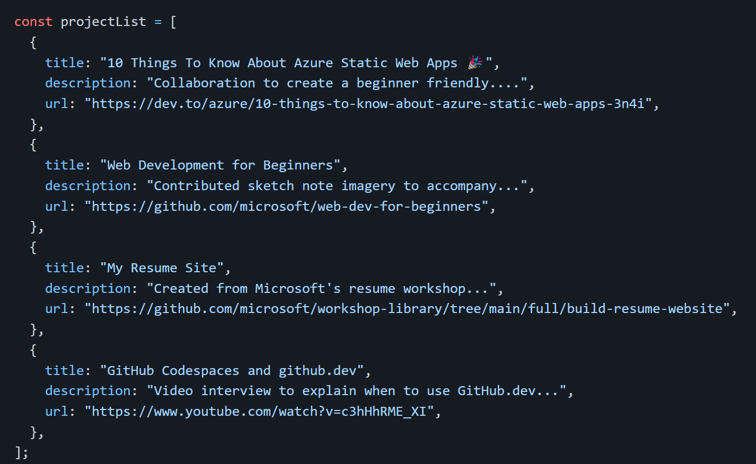
3. Add items you've worked on
Go to Portfolio.jsx to the projectList variable.
This is a JavaScript array of objects. Each item you want to highlight needs: title, description and URL.
Notes:
3️⃣ Add items you've worked on
The portfolio section is the area for you to highlight items you've worked on. These would be articles, videos, logo designs, GitHub projects, anything that highlights you!
Go to Portfolio.jsx to the projectList variable. This is a JavaScript array of objects. Each item you want to highlight needs: title, description and URL.
The sample design has 4, but the number you include is up to you.
[Mention the code from above]

Slide 17
Deploy your web application
Notes:
Project includes the setup needed for you to deploy free to both Azure Static Web Apps and GitHub Pages.

Slide 18
Azure Static Web Apps
With your Project open in Codespaces follow the next steps
Notes:
Azure Static Web Apps is Microsoft's hosting solution through Azure for static sites (or sites that are rendered in the user's browser, not on a server). Will provide you additional opportunities to expand your site through Azure Functions, authentication, staging versions and more.
With your project open in Codespaces:
Go to the Azure icon in the left sidebar. Log in if you are not already. If you are new to Azure, follow the provide prompts to create your account.
From Azure menu click “+” sign and then “Create Static Web App”.
If you are not logged into GitHub you will be prompted to log in, and if you have any pending file changes you will then be prompted to commit those changes.
You will be prompted to set you application information:
Region: pick the one closest to you
Project structure: select "React"
Location of application code: /
Build location: dist
When complete you will see notification at the bottom of your screen, and a new GitHub Action workflow will be added to your project. If you click “Open Action in GitHub” you will see the action that was created for you, and it is currently running.

Slide 19
GitHub Pages
With your Project open in Codespaces follow the next steps
Notes:
GitHub Pages allows you to host websites directly from your GitHub repository. This project is already set up for you to get your portfolio deployed to GitHub pages with minimal steps.
With your project open in Codespaces: [Guide your audience with the following steps]
Go to package.json and find the "homepage" value, and update it to http://{github-username}.github.io/{repo-name}, where github-username is your GitHub username and repo-name is the what you named this portfolio repo when you created it.
Commit and push that change to package.json to your GitHub remote repo.
Open a new terminal from the menu or by pressing crtl + shift + ```
Within the terminal window run npm run deploy. This will first run the predeploy script to build the project, followed by the deploy script that will push those bundled files to a new branch on your repo (gh-pages) that will be used for you GitHub Pages site.
When completed, within your repo, go to Settings and Pages. There you will see that a page has been set up to for you against the gh-pages branch, and you should see the url (that should match the “homepage” value you set in package.json)

Slide 20
Next Challenges
1. Customize your Codespace
2. Update to smooth scroll to a section
3. Animate desk photo
4. Add a new section
Follow the steps, here.

Slide 21
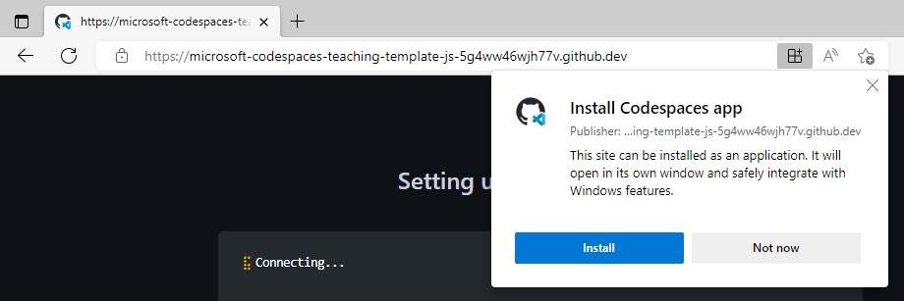
Learn More
GitHub Codespaces docs overview
Use dev containers locally
Additional questions

Slide 22
Found an issue or have an idea for improvement?
Help us make this template repository better by letting us know and opening an issue!.

